Slide 1
Jenkins Architecture

Slide 2
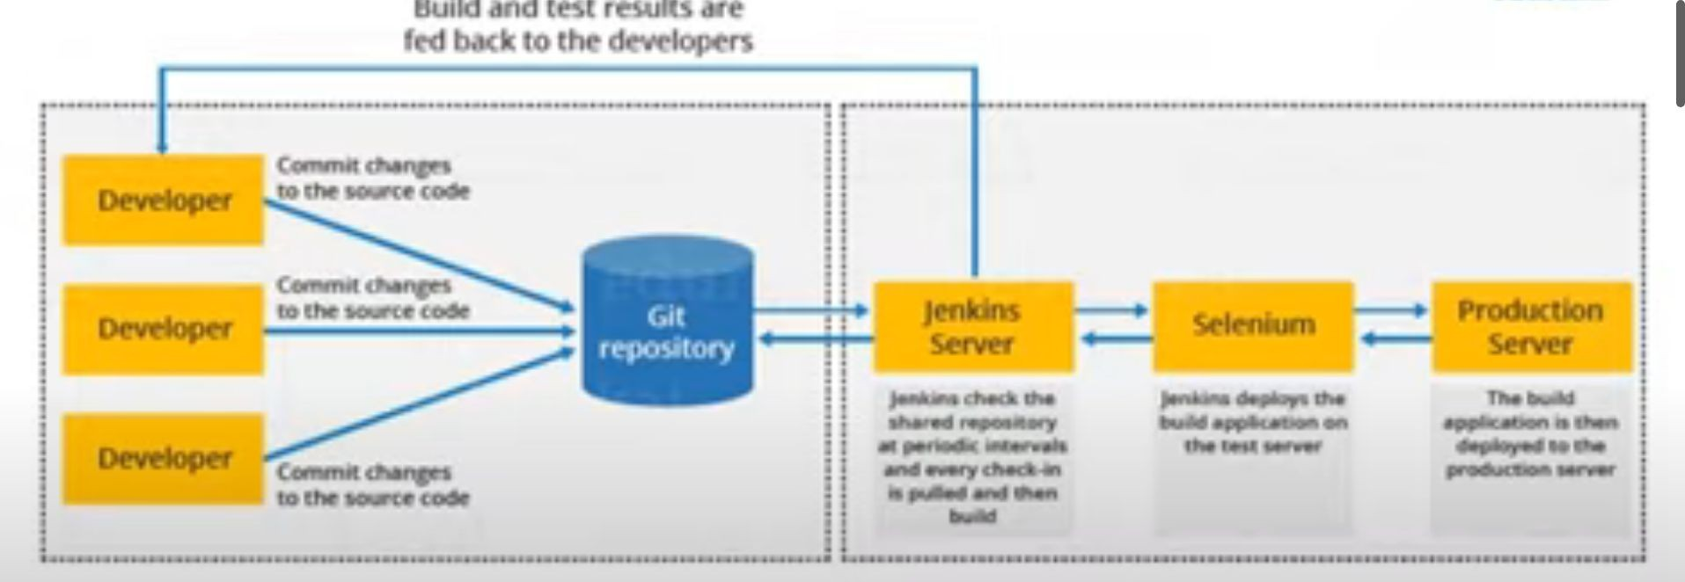

Slide 3
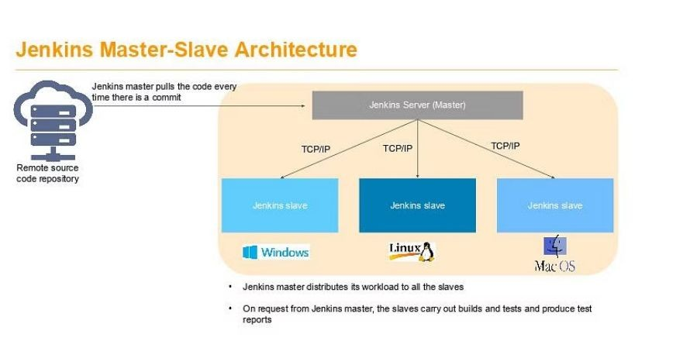

Slide 4
Advantages and disadvantages of Jenkins
Advantages
Jenkins is an open source tool with great community support. It has been the most preferred CI-CD tool for over a decade.
It has a rich plugin ecosystem. There are over a thousand plugins available, that can be used to enhance the functionality of Jenkins environment and suit the needs of the organization.
Jenkins can be easily integrated with a number of popular cloud platforms such as Google Cloud, DigitalOcean, Amazon EC2 etc.

Slide 5
JENKINS

Slide 6
WHAT IS JENKINS?
Jenkins is an open source automation tool written in Java programming language that allows continuous integration.
Jenkins builds and tests our software projects which continuously making it easier for developers to integrate changes to the project, and making it easier for users to obtain a fresh build.
It also allows us to continuously deliver our software by integrating with a large number of testing and deployment technologies.
Jenkins offers a straightforward way to set up a continuous integration or continuous delivery environment for almost any combination of languages and source code repositories using pipelines.

Slide 7
It adds development life-cycle processes of all kinds, including build, document, test, package, stage, deploy static analysis and much more.
Jenkins achieves CI (Continuous Integration) with the help of plugins. Plugins is used to allow the integration of various DevOps stages. If you want to integrate a particular tool, you have to install the plugins for that tool. For example: Maven 2 Project, Git, HTML Publisher, Amazon EC2, etc.
Possible steps executed by Jenkins are for example:
Perform a software build using a build system like Gradle or Maven Apache
Execute a shell script
Archive a build result
Running software tests

Slide 8
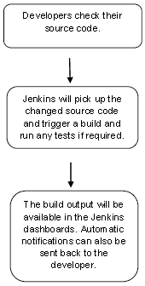
WORKFLOW

Slide 9
TYPES OF JOBS IN JENKINS
We can create below types of jobs in Jenkins.
Freestyle Project
Pipeline
Multiconfiguration Projects
Folder
GitHub organization
Mutlibranch Pipeline

Slide 10
Freestyle is the simplest method to build project. They are repeatable and contain both build steps and post-build actions.
Even though freestyle jobs are highly flexible, they support a limited number of general build and post-build actions. Any specialized or non-typical action a user wants to add to a freestyle project requires additional plugins.
FREESTYLE BUILD

Slide 11
PIPELINES
Jenkins Pipeline is a suite of plugins that supports implementing and integrating continuous delivery pipelines into Jenkins.
Jenkins pipeline enables you to define the Jenkins job via pipeline which is easy to maintain and review.
Jenkins pipelines are robust and pipelines will be secure even if the server undergoes an unpredicted restart.
With Jenkins Pipelines, you can add CI-CD to big projects as well as with Jenkins pipelines you can run multiple jobs.

Slide 12
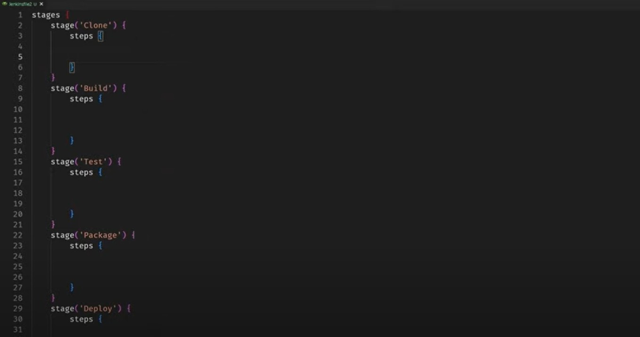
It contains a group of states called build, deploy, test and release. These events are interlinked with each other. Every state has its events, which work in a sequence called a continuous delivery pipeline.

Slide 13
Jenkins walkthrough

Slide 14
Installing Jenkins
Ways to install:
You can install Jenkins directly on an OS.
You can install Jenkins in a container environment such as docker or kubernetes.

Slide 15
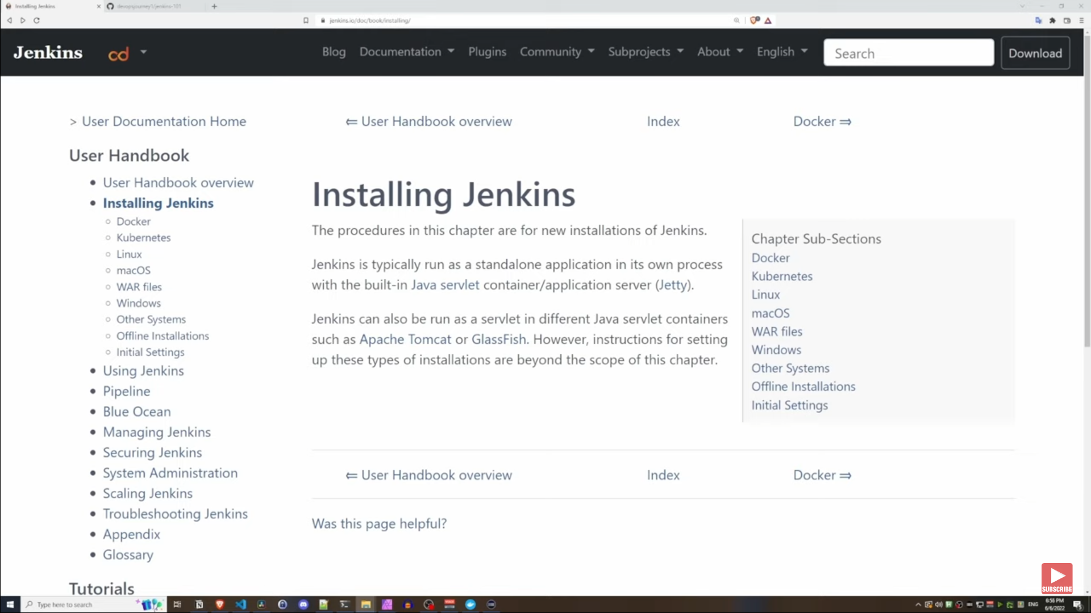

Slide 16
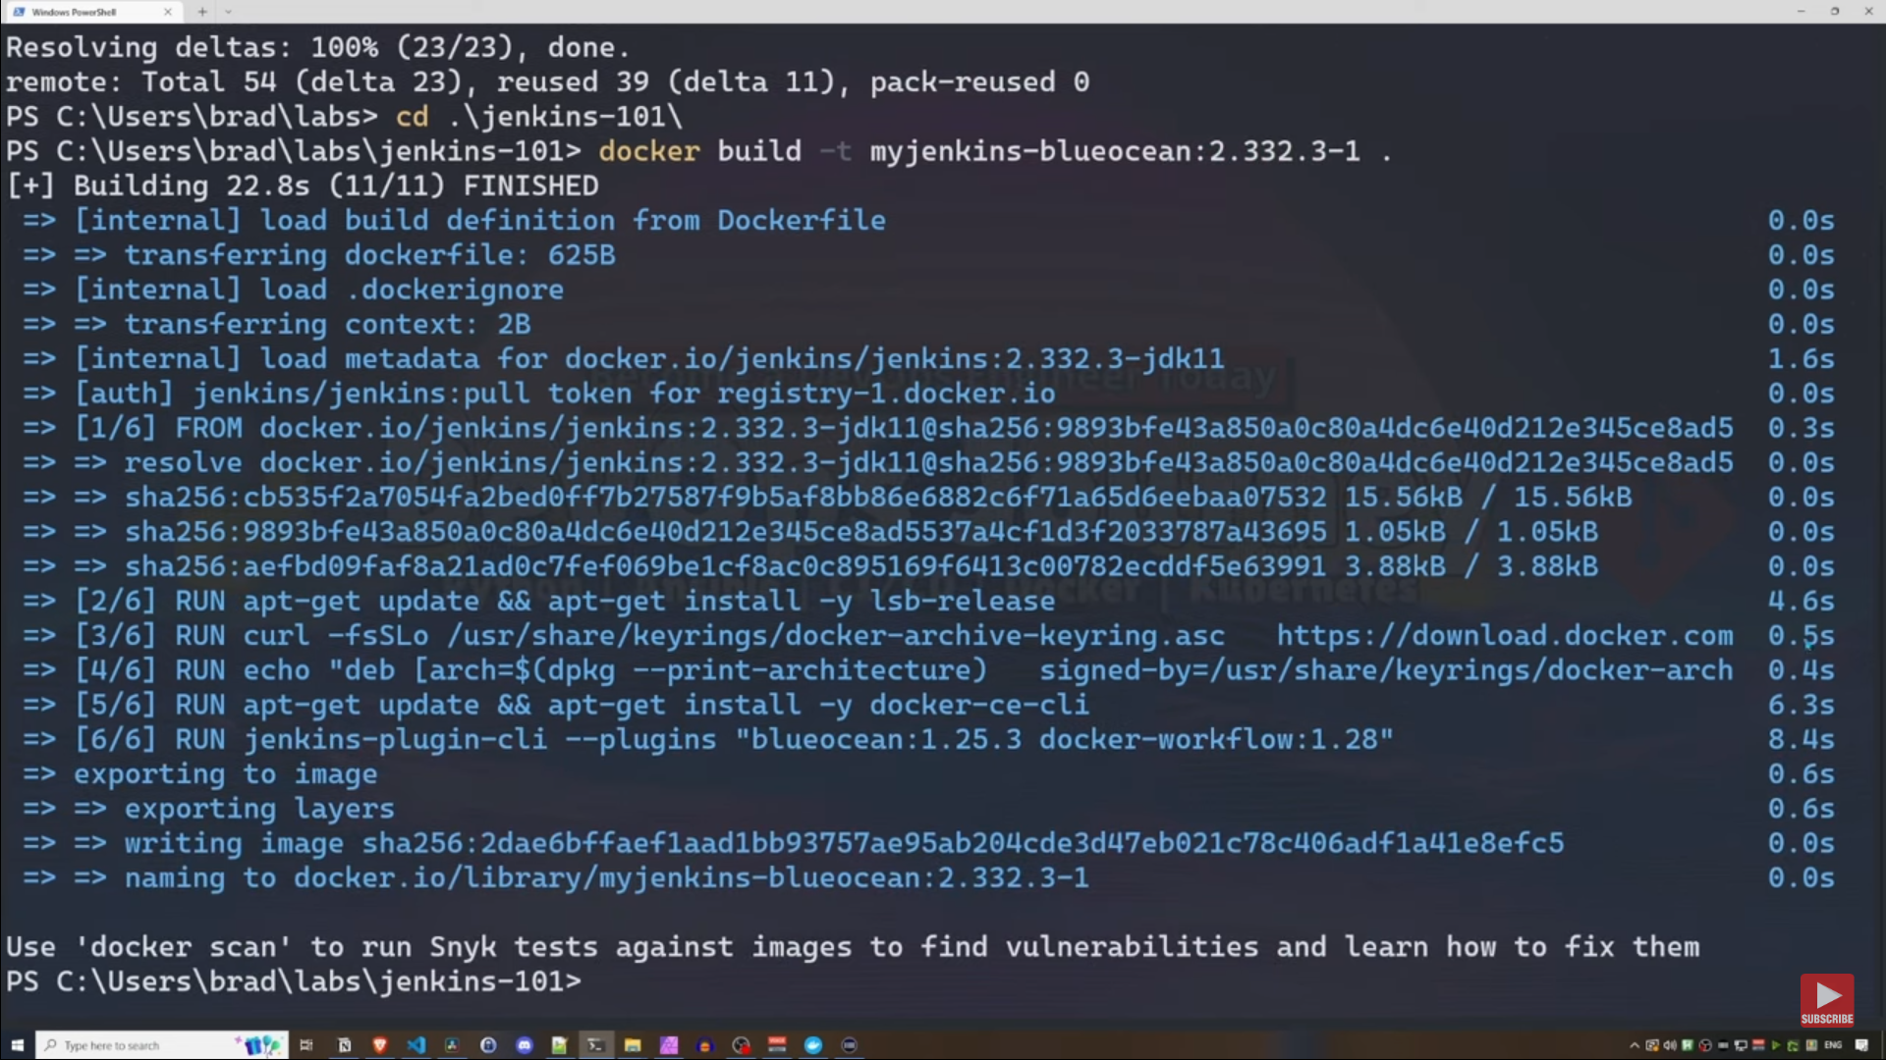
Building a docker image

Slide 17
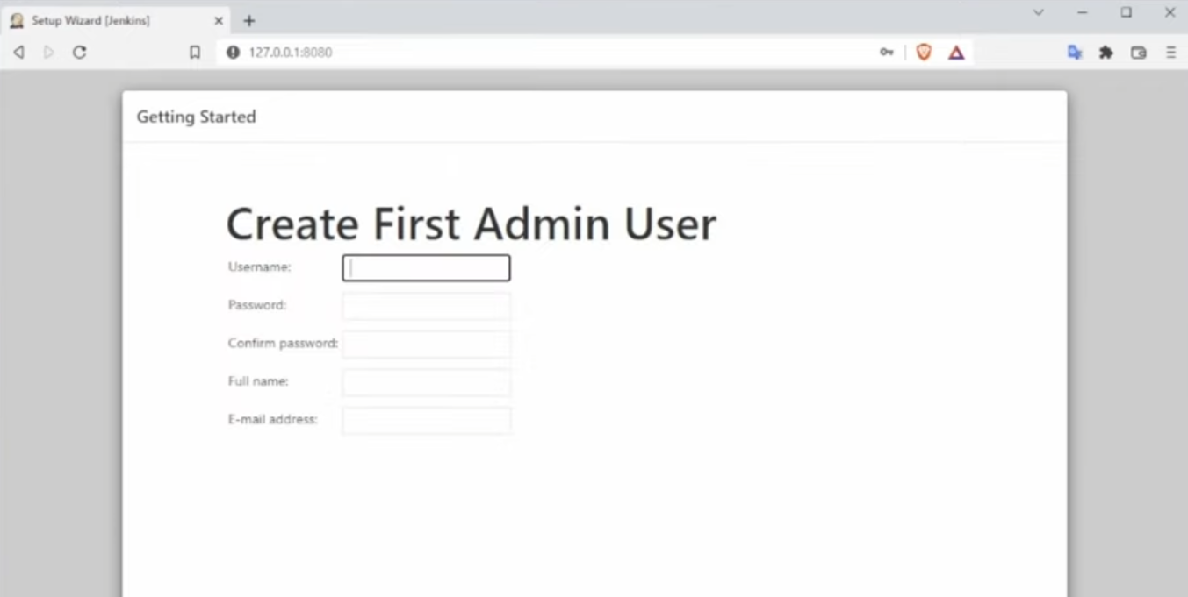

Slide 18
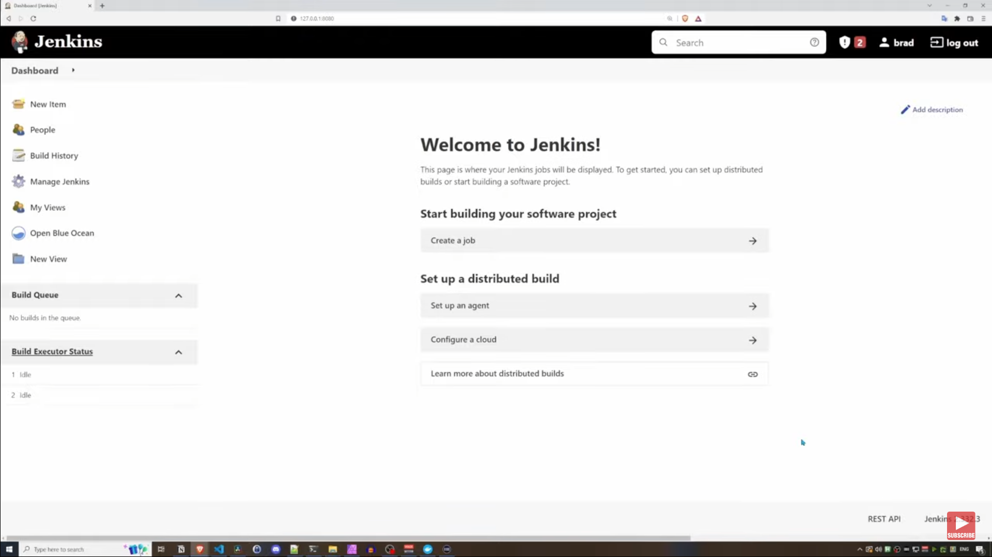

Slide 19
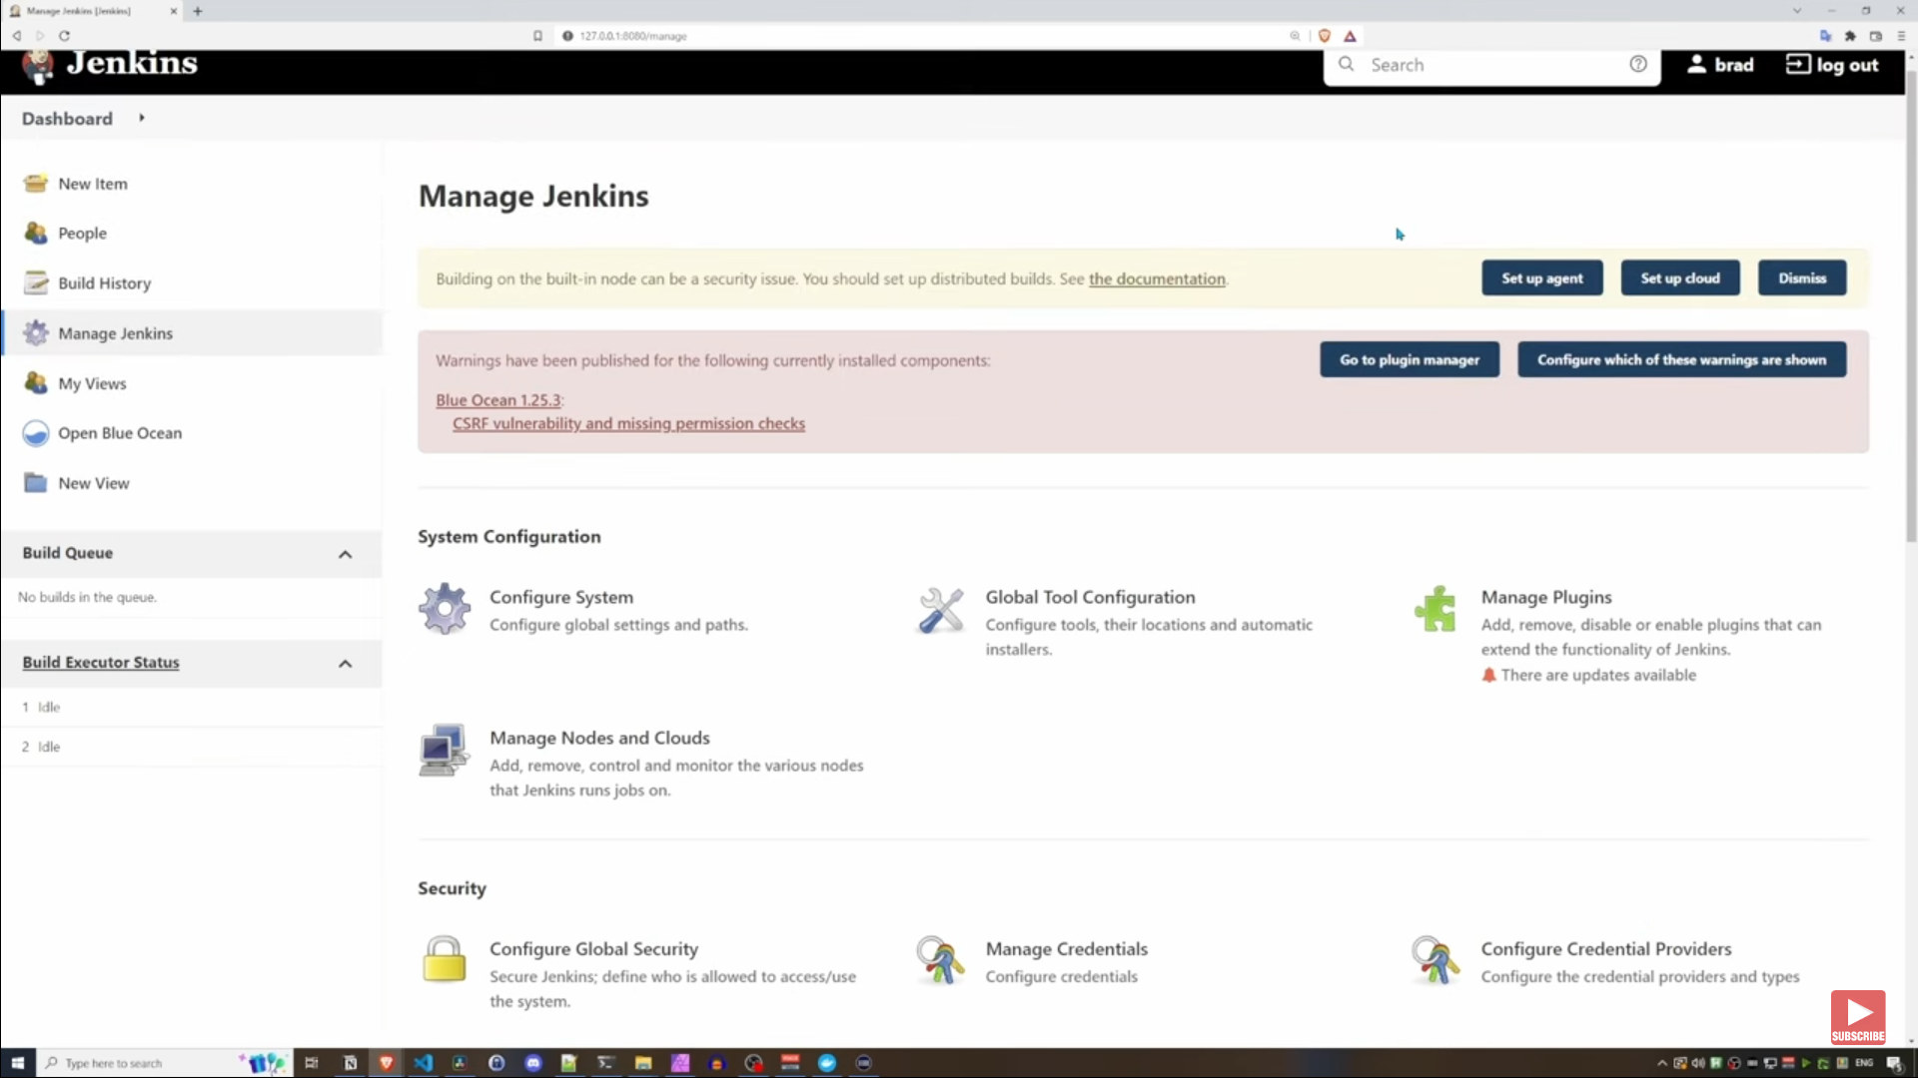

Slide 20
Creating a freestyle project
Jenkins freestyle projects allow users to automate simple jobs, such as running tests, creating and packaging applications, producing reports, or executing commands.

Slide 21
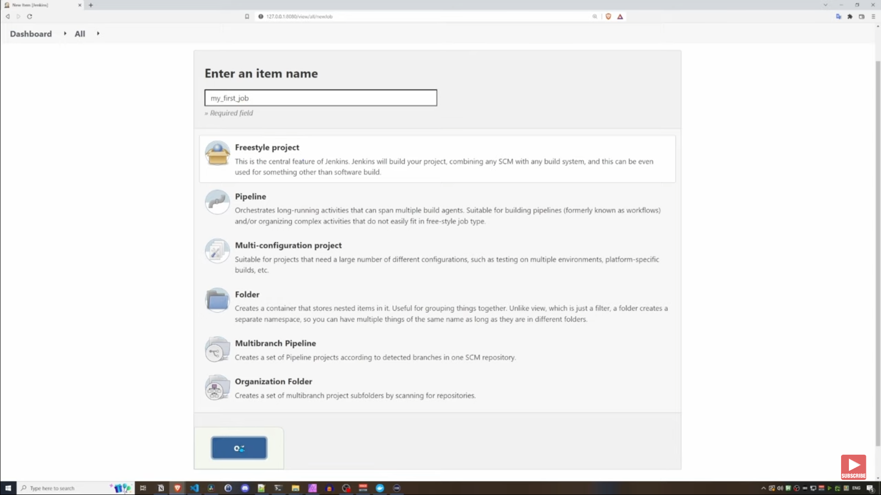

Slide 22
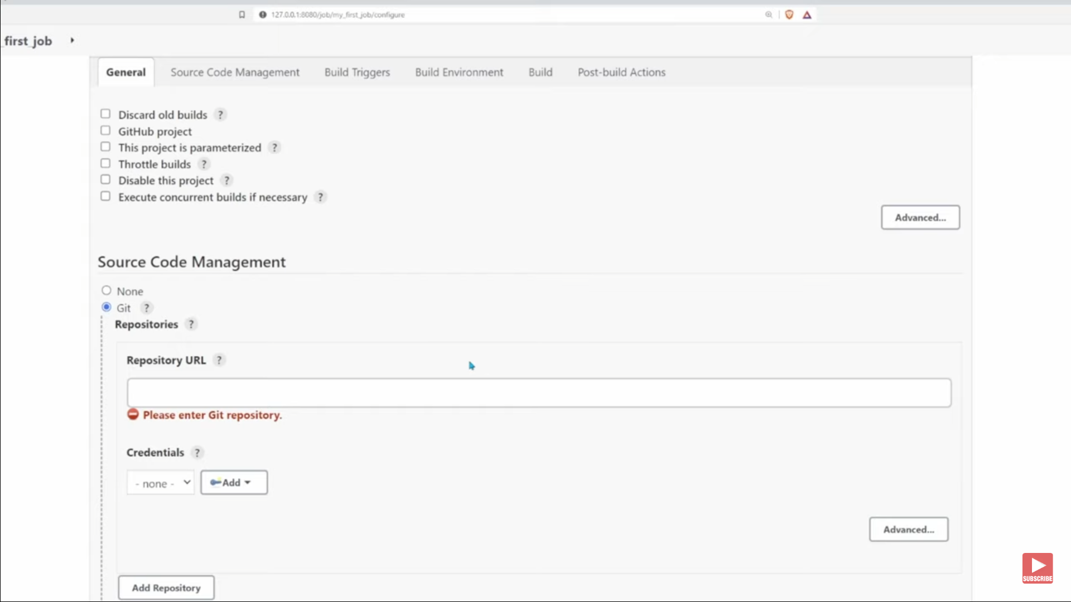

Slide 23
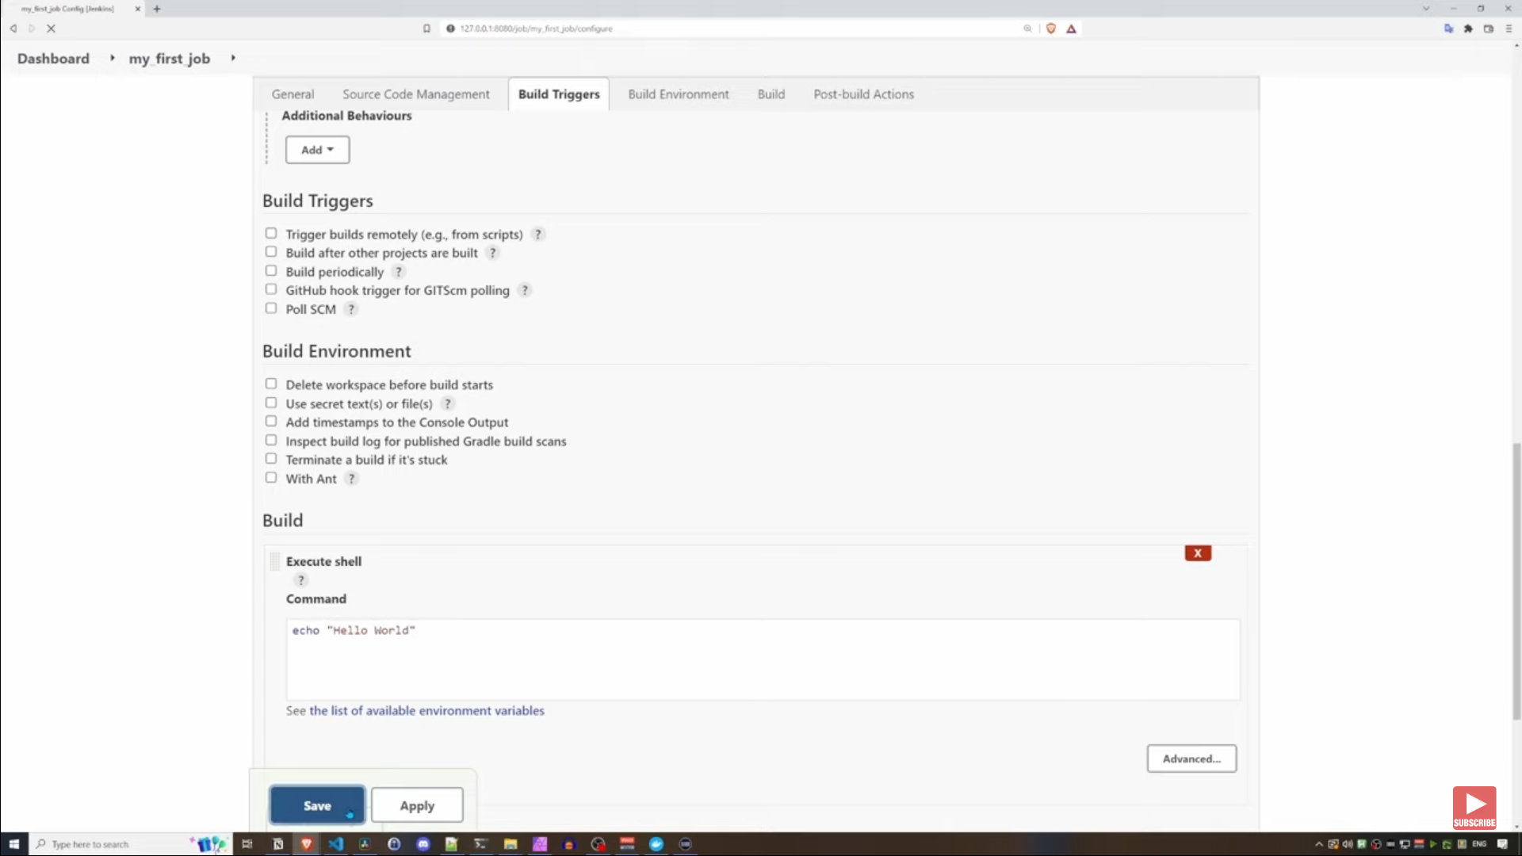

Slide 24
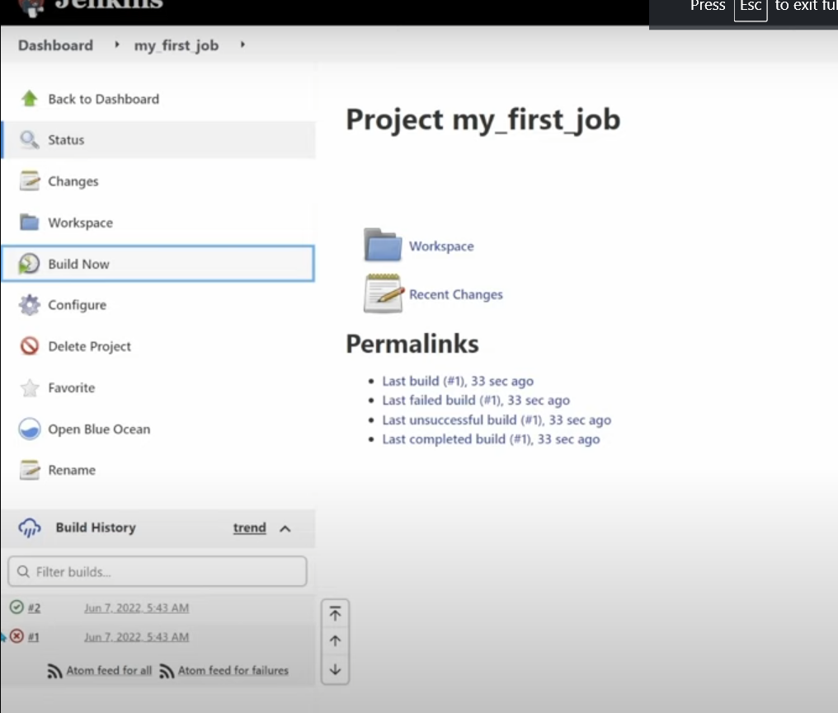

Slide 25
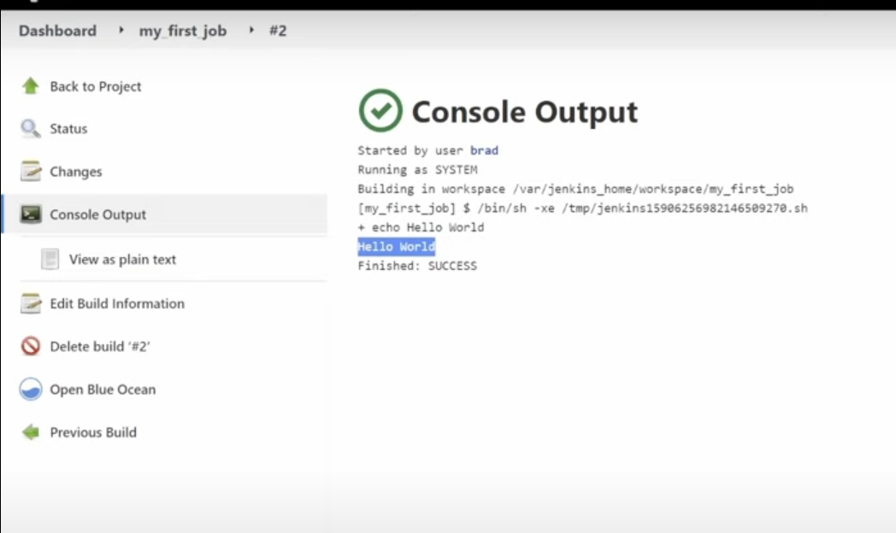

Slide 26
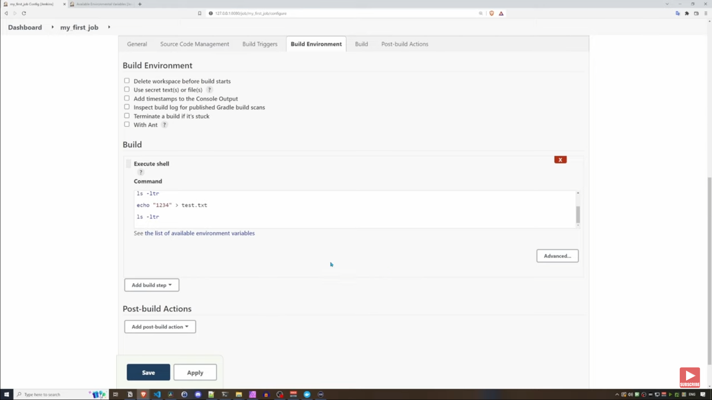

Slide 27
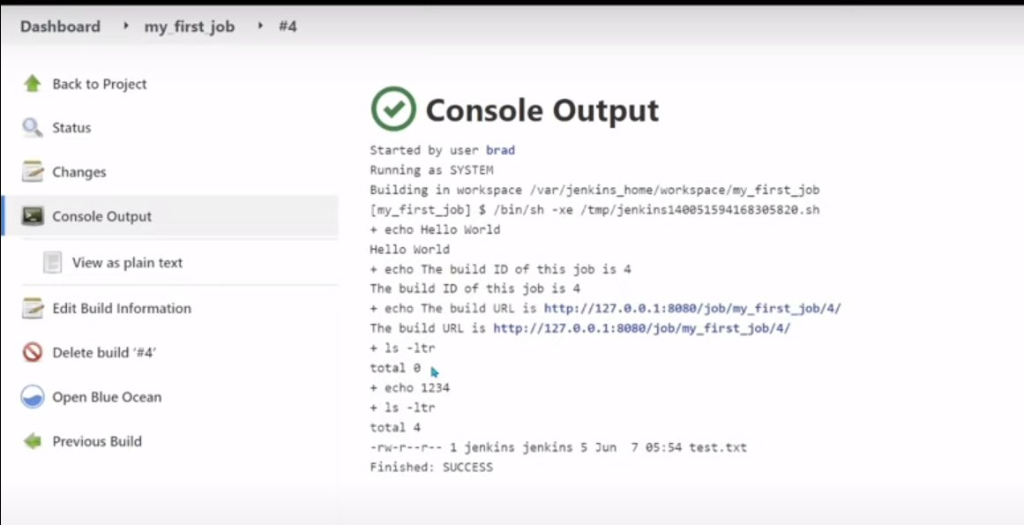

Slide 28
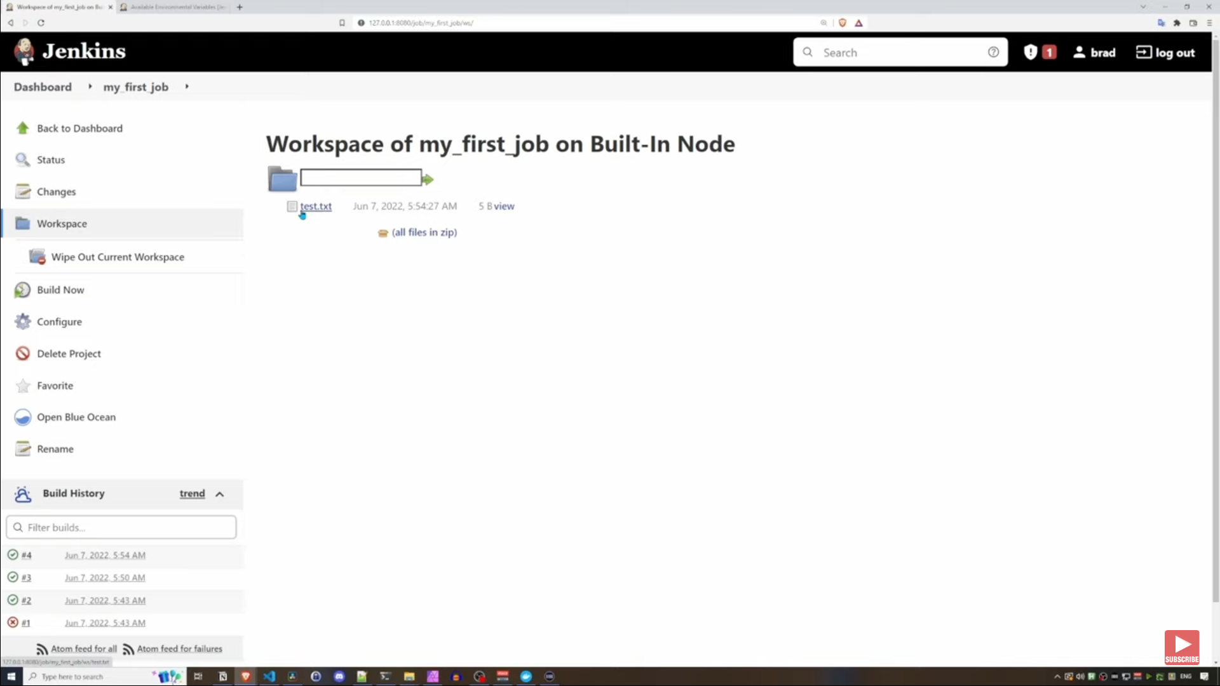

Slide 29
File system
and workspace
in Jenkins

Slide 30
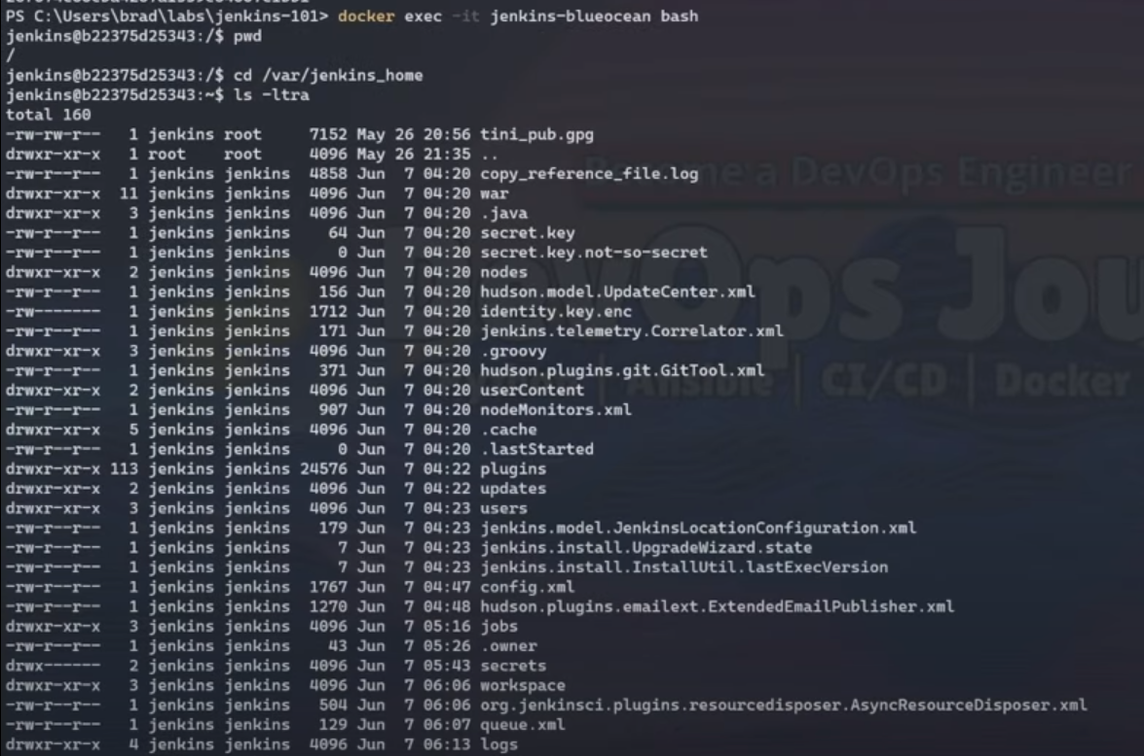

Slide 31
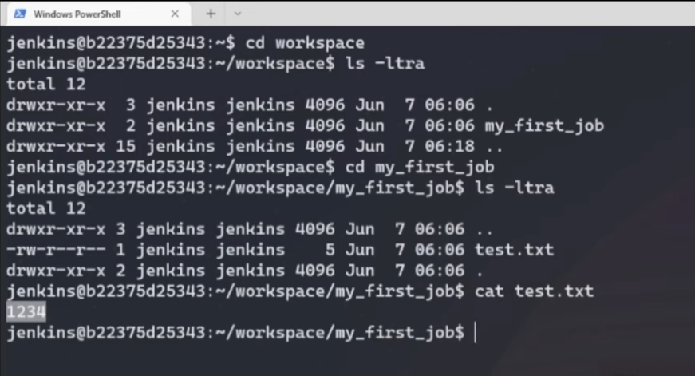

Slide 32
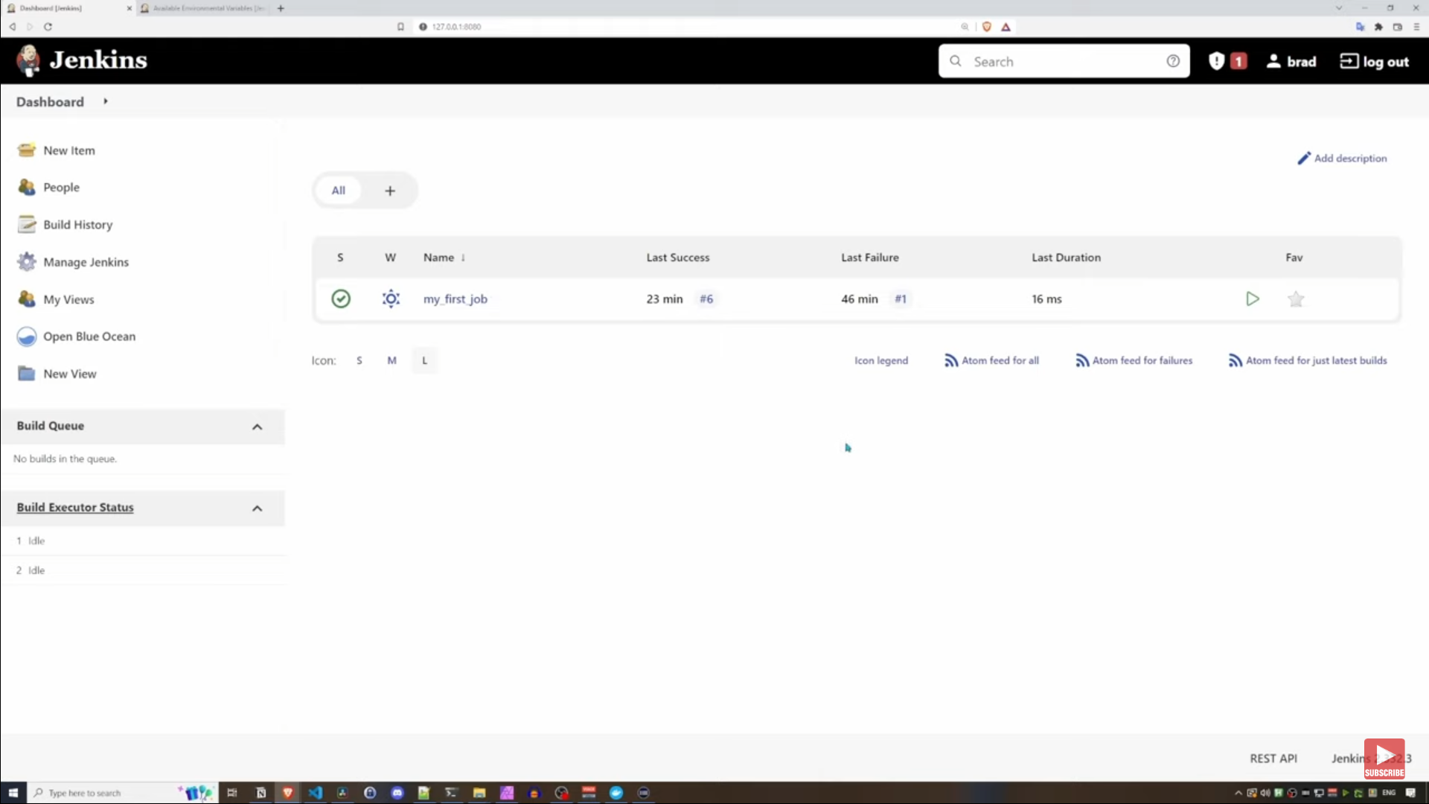

Slide 33
A sample demo of a jenkins job

Slide 34
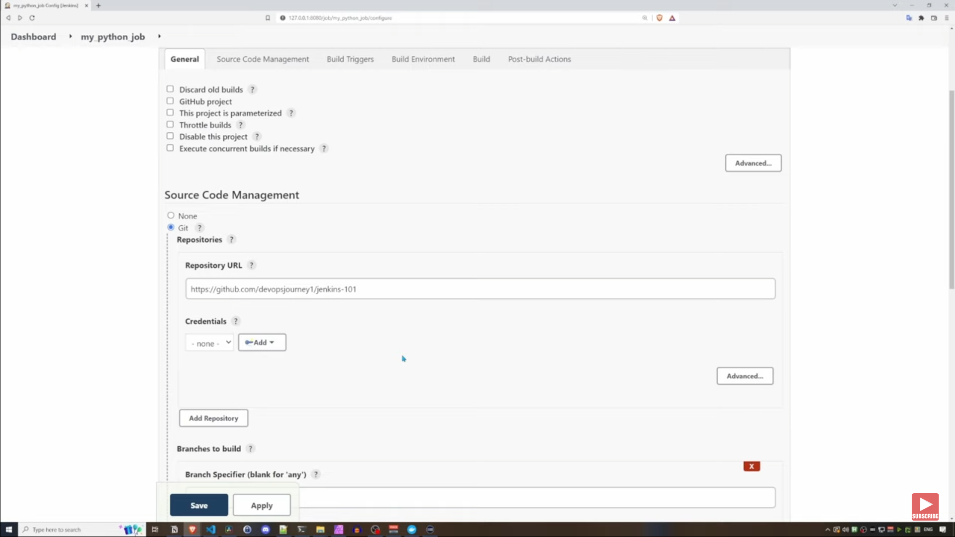

Slide 35
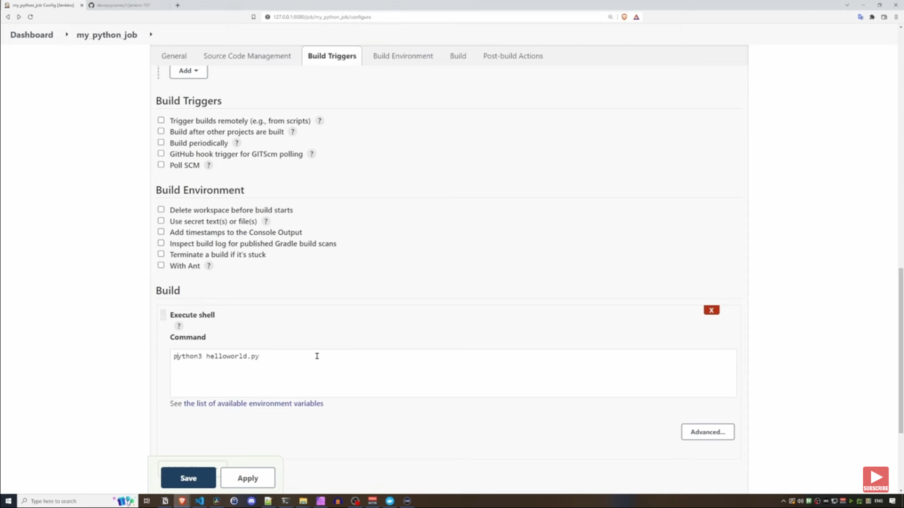

Slide 36
Creating a
Cloud Agent

Slide 37
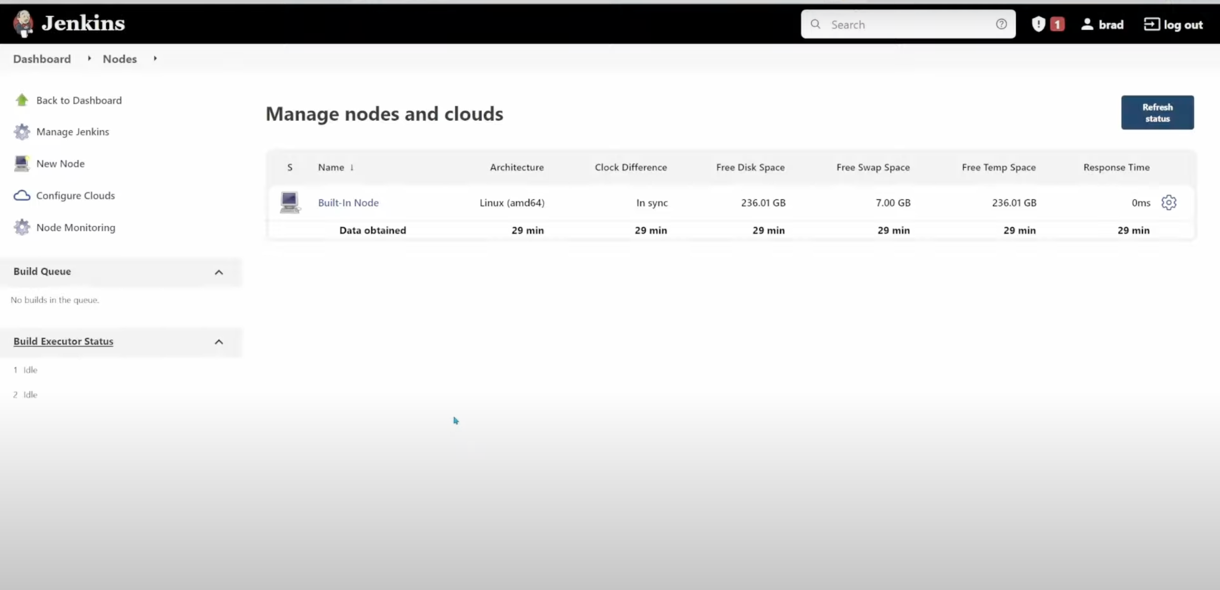

Slide 38
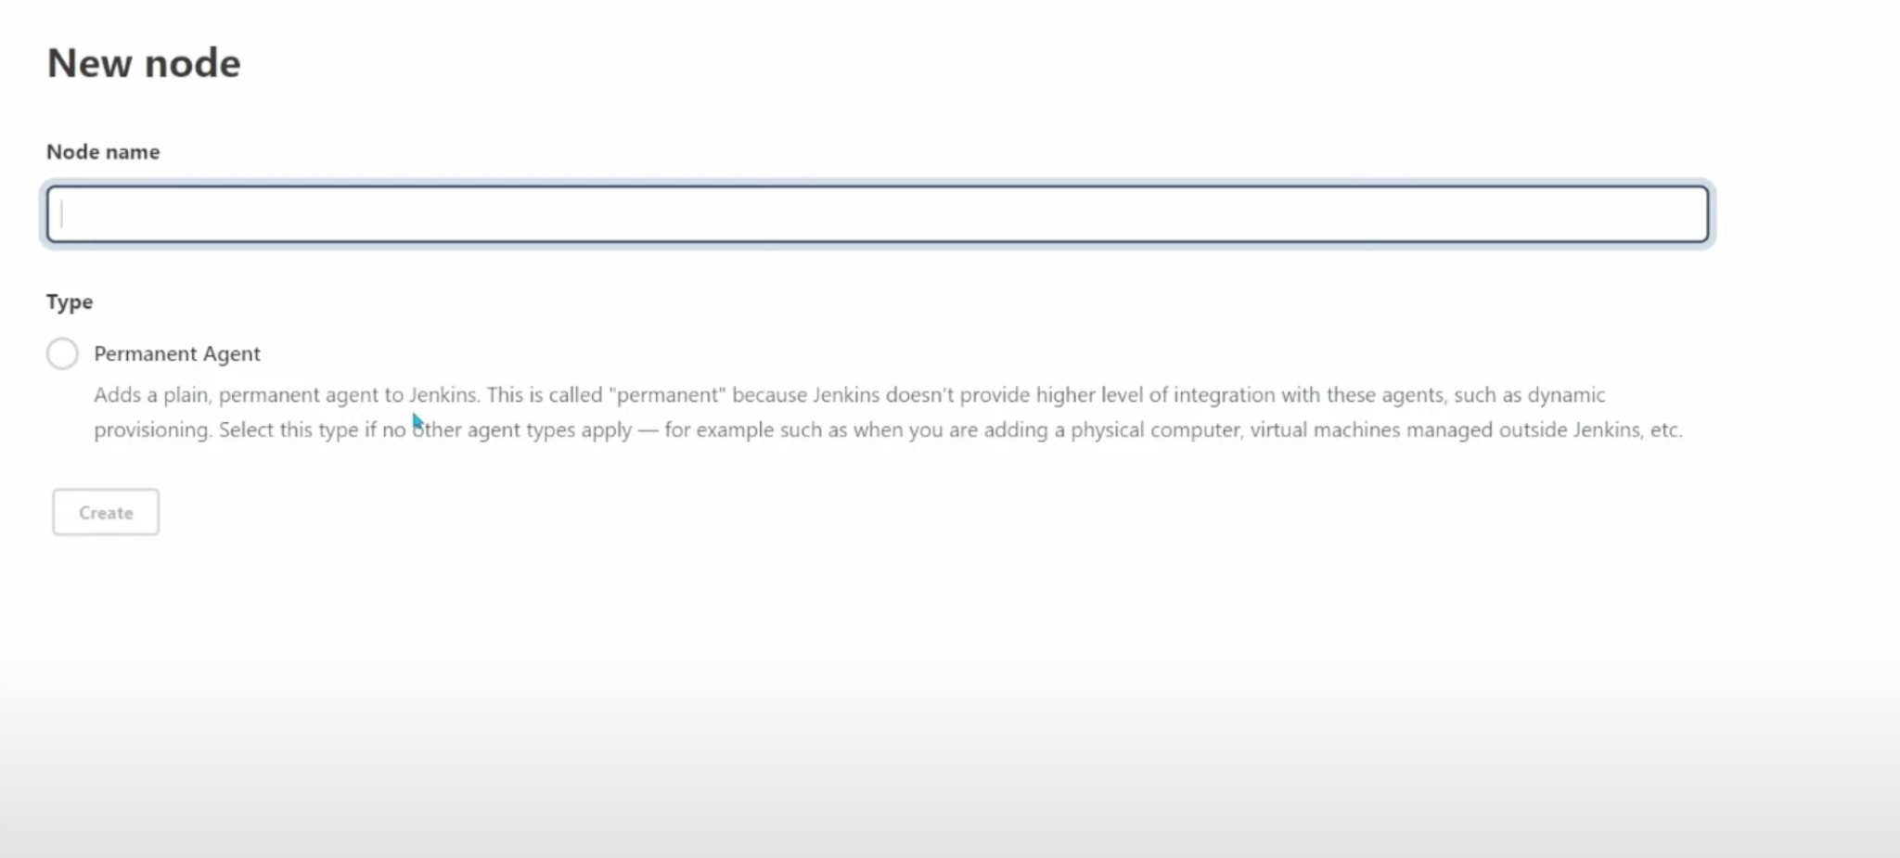
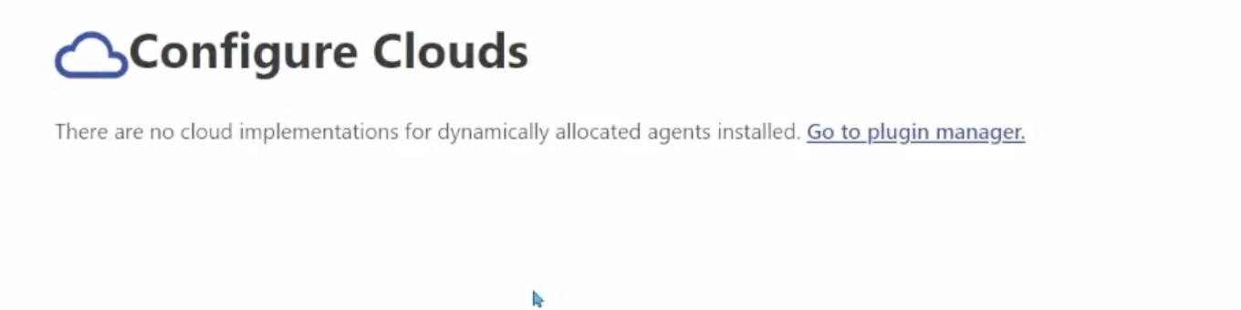

Slide 39
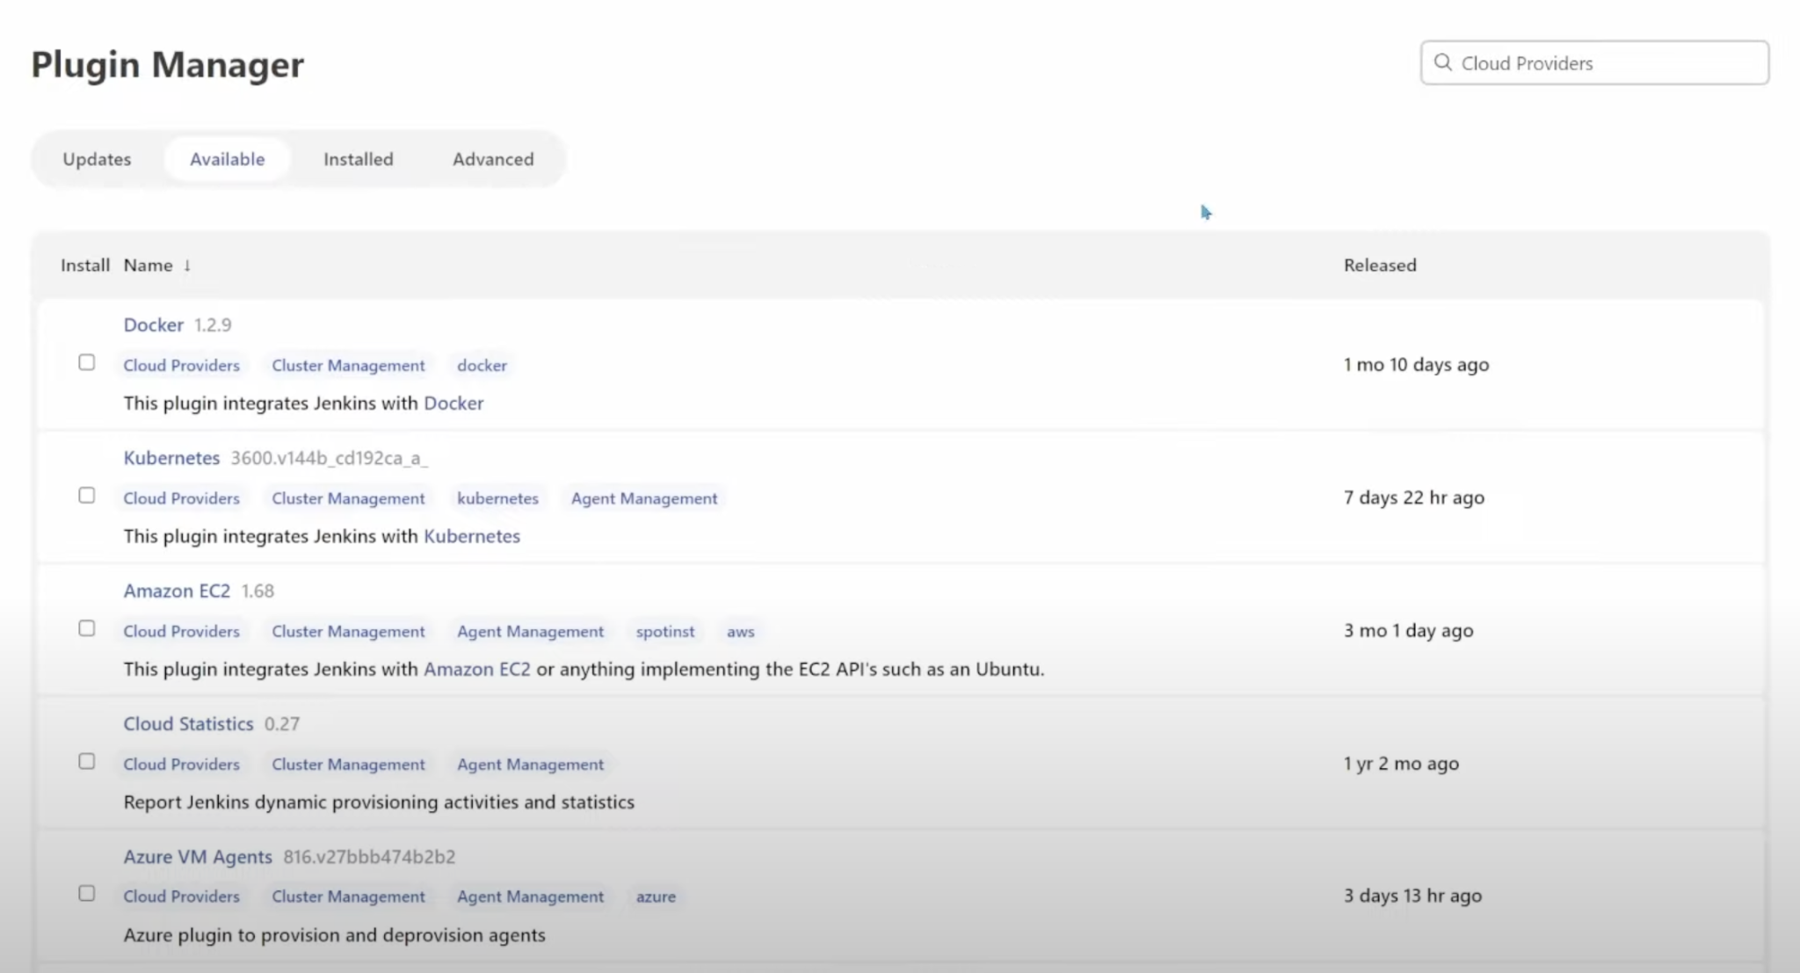

Slide 40
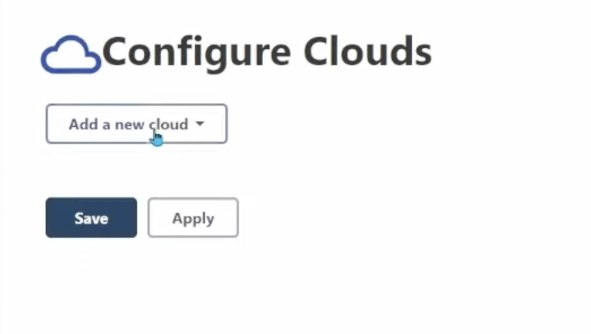
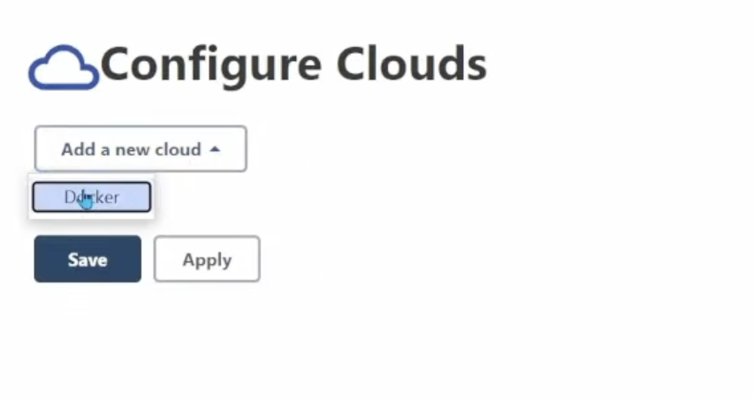

Slide 41
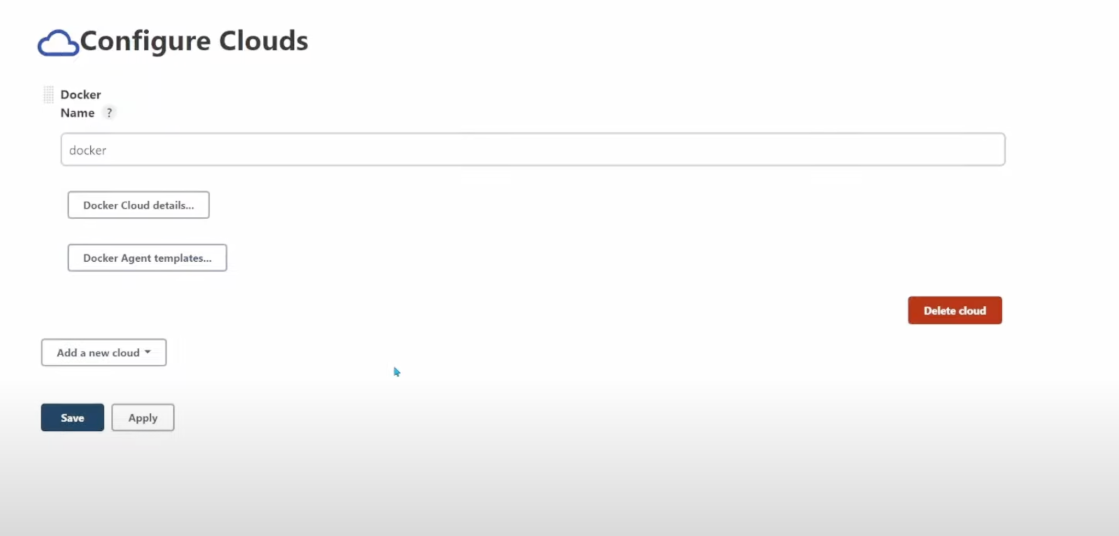

Slide 42
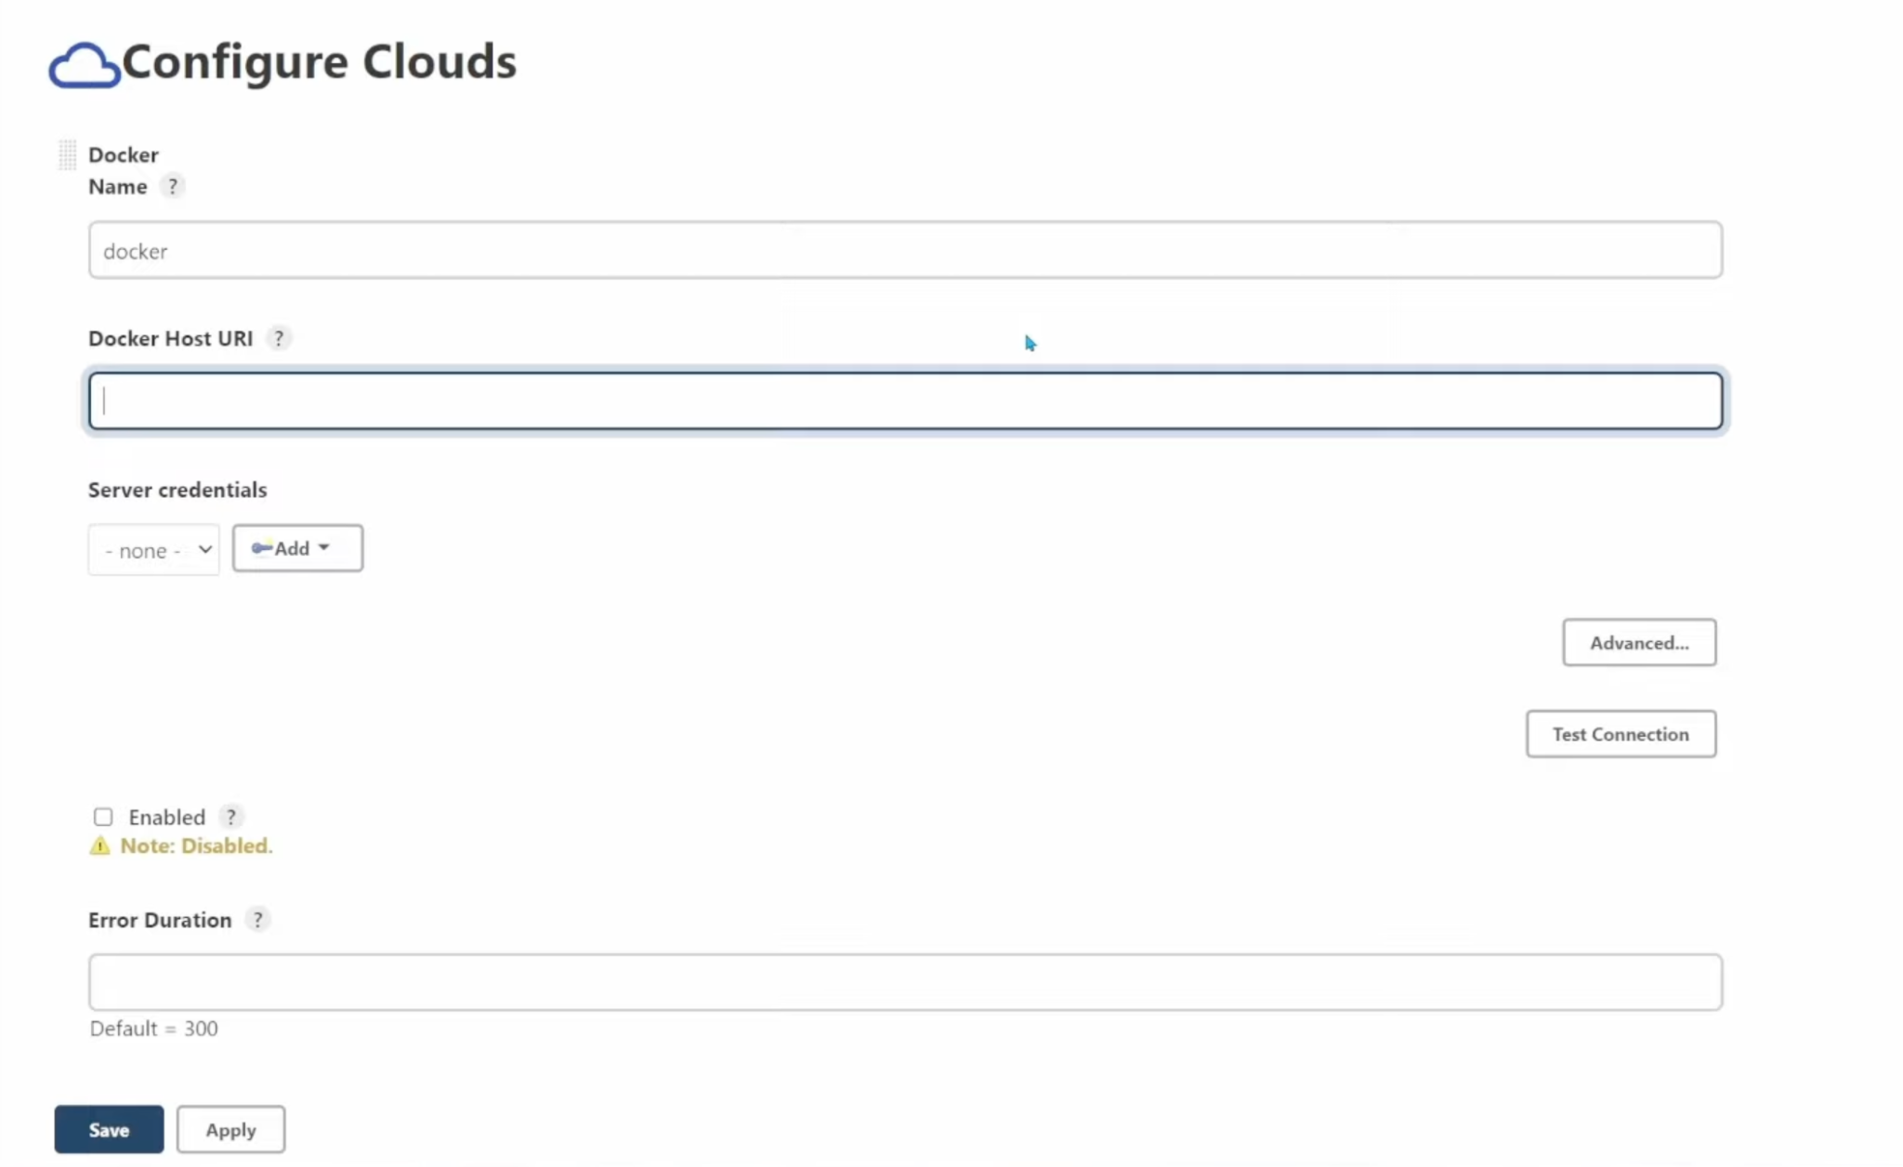

Slide 43
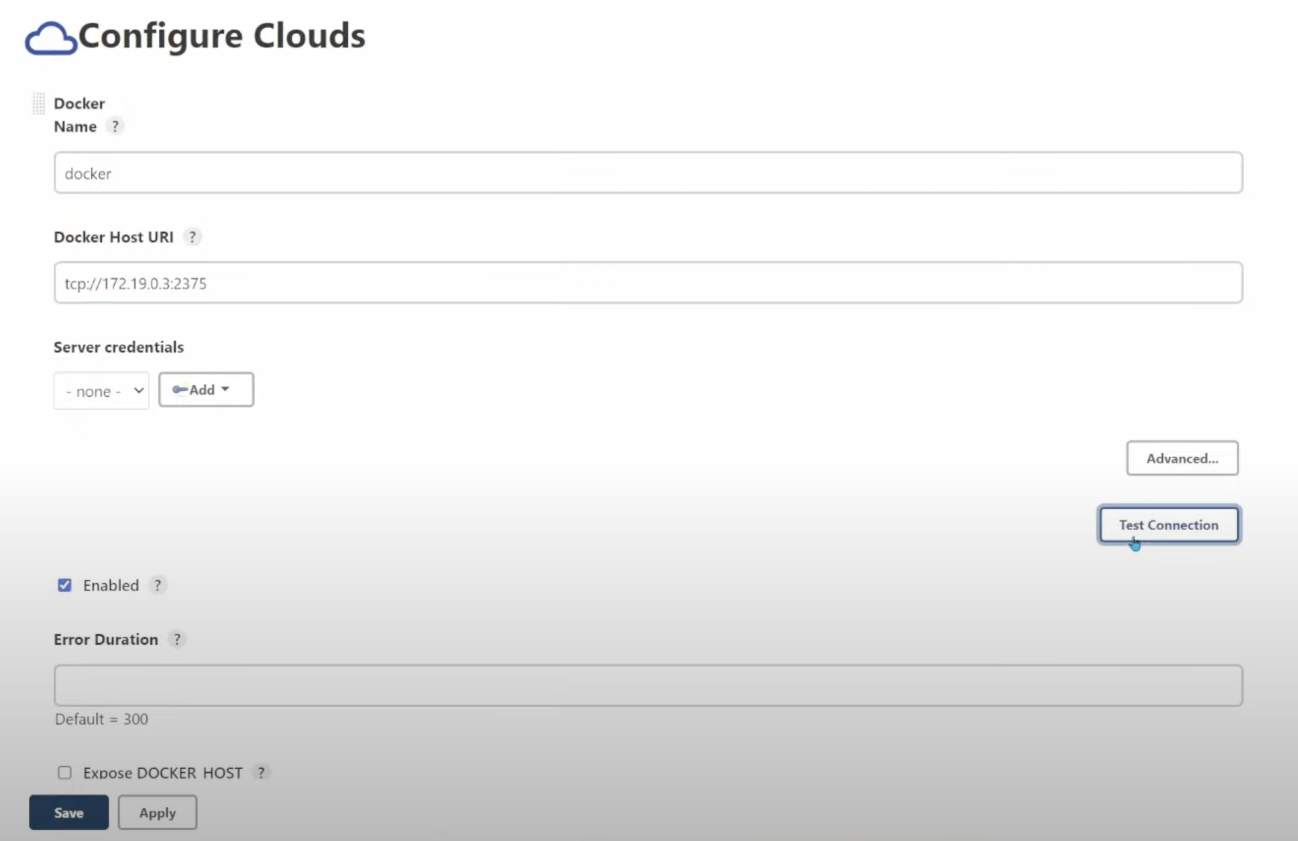

Slide 44
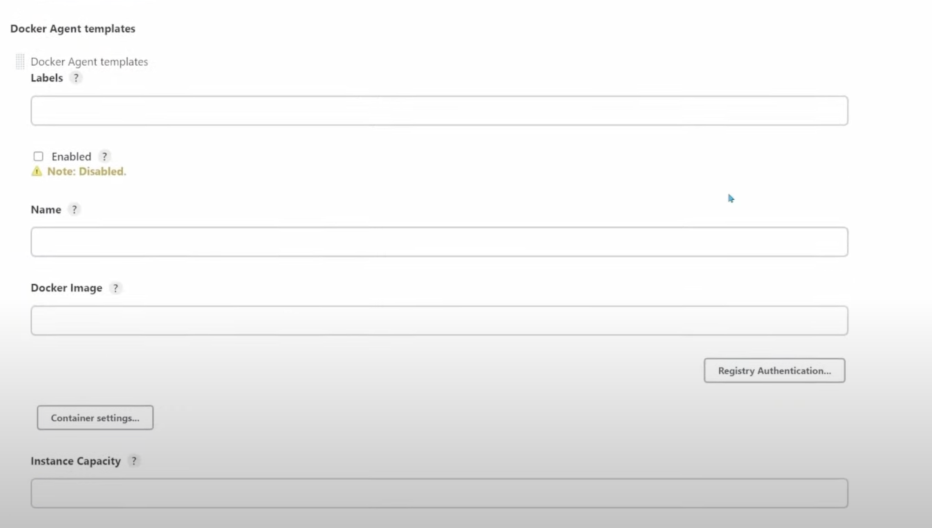

Slide 45
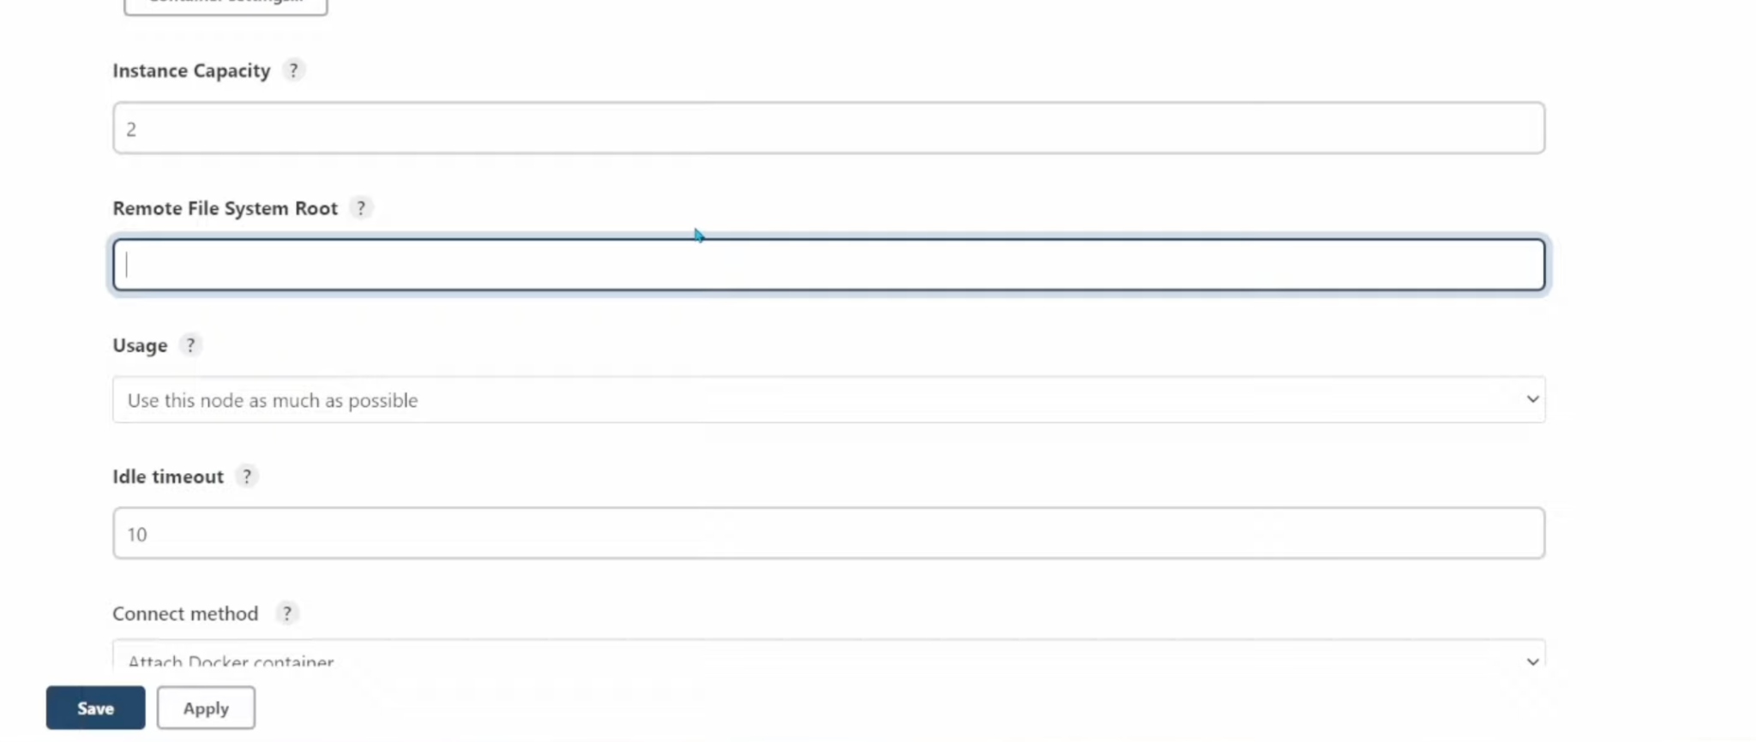

Slide 46
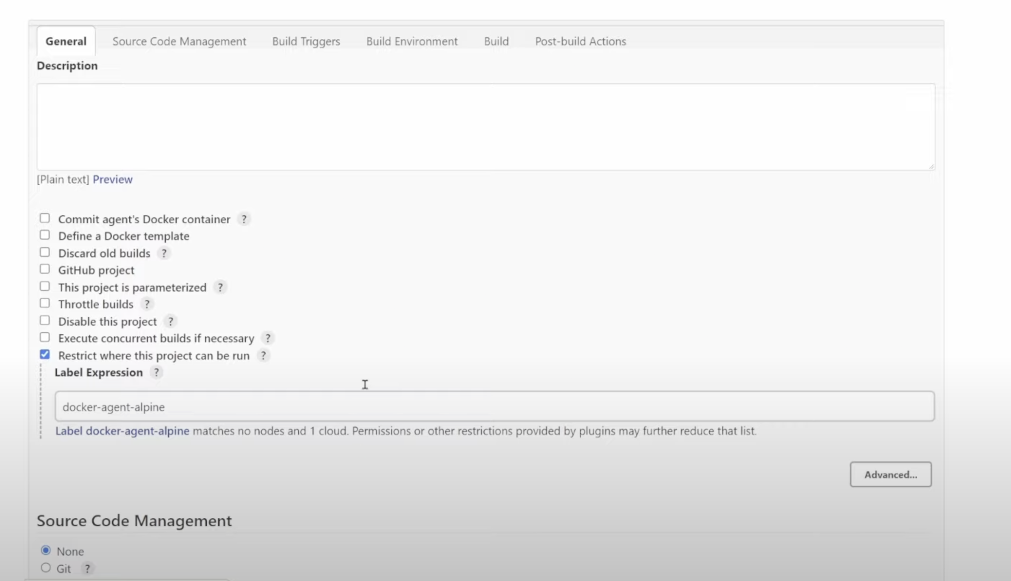

Slide 47
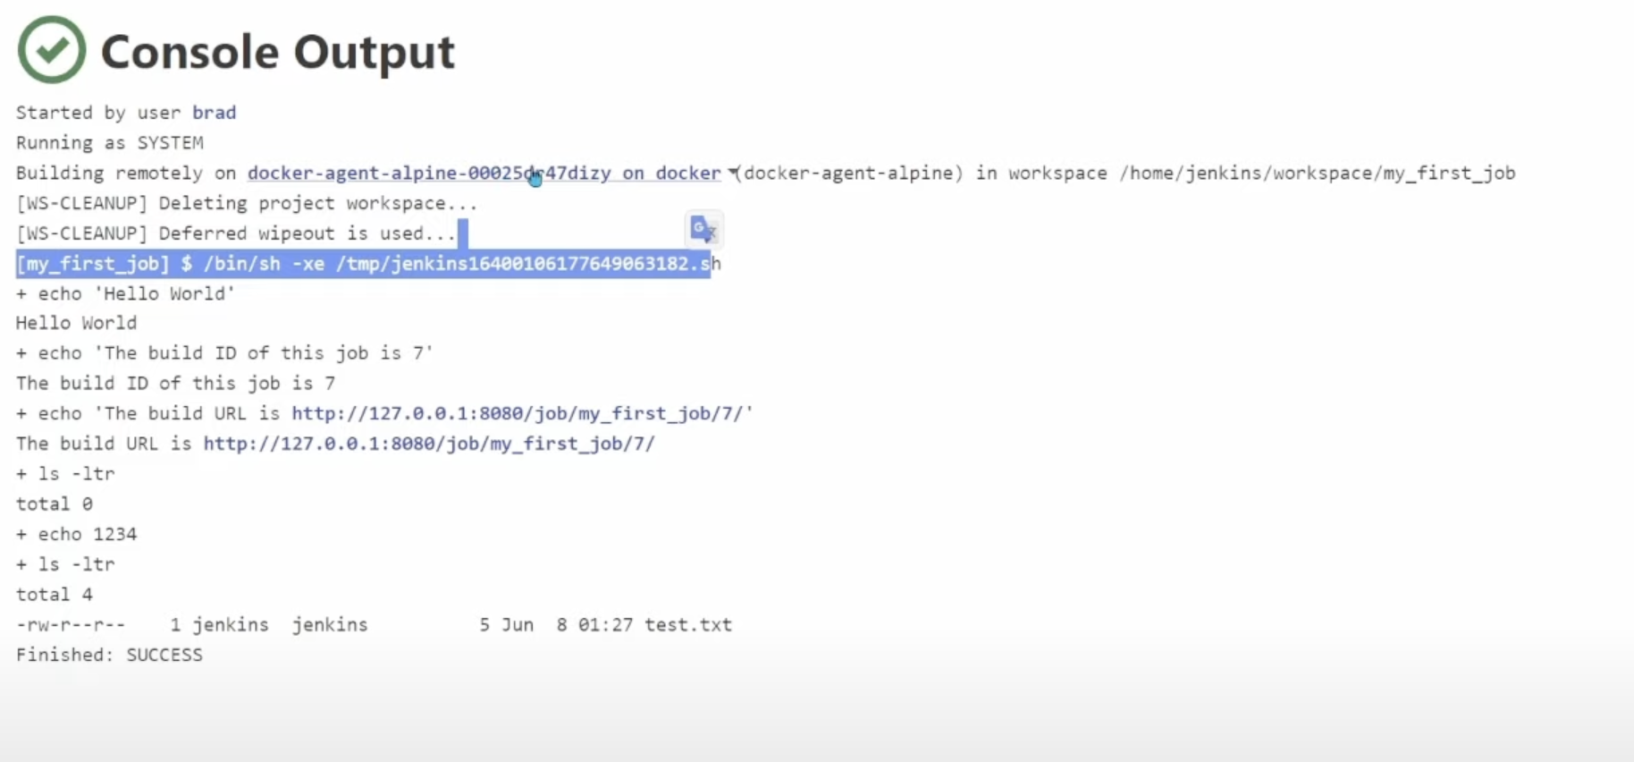

Slide 48
Creating a
Pipeline

Slide 49
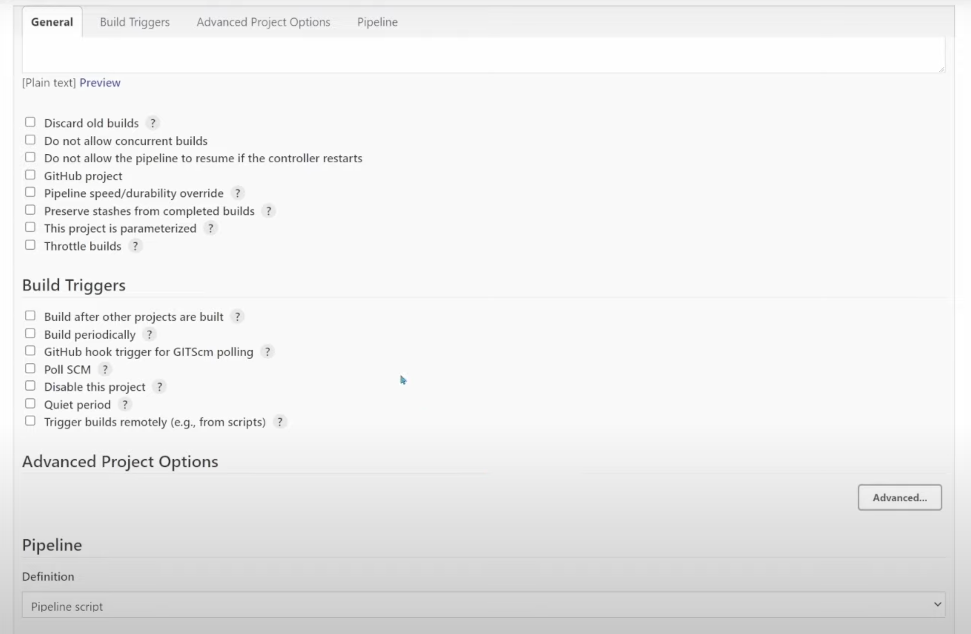

Slide 50
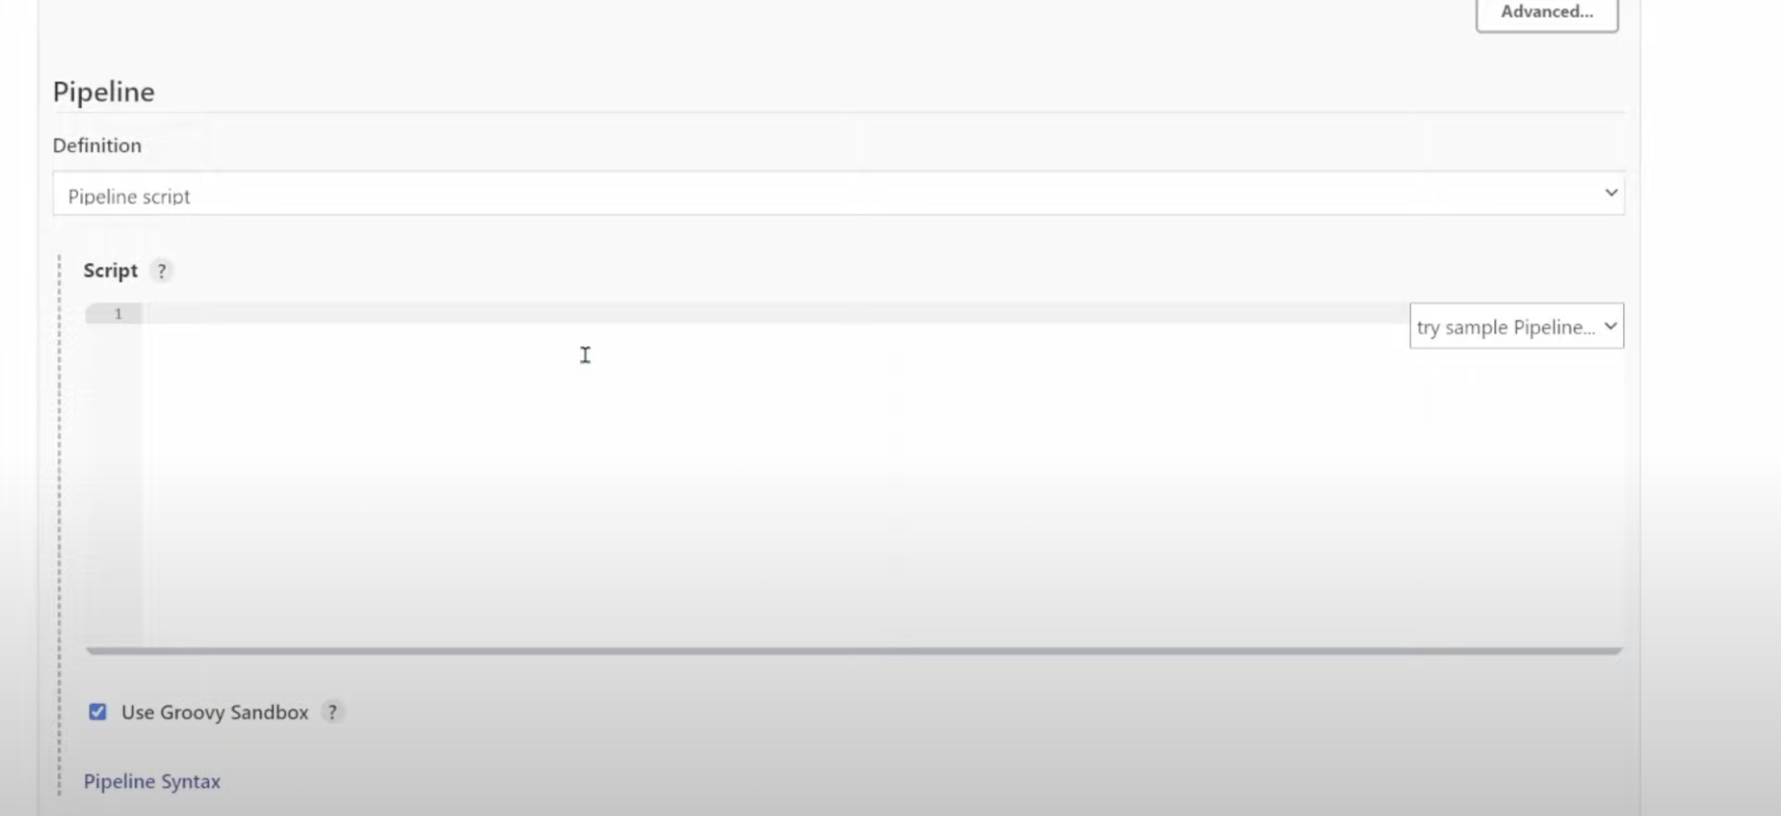

Slide 51
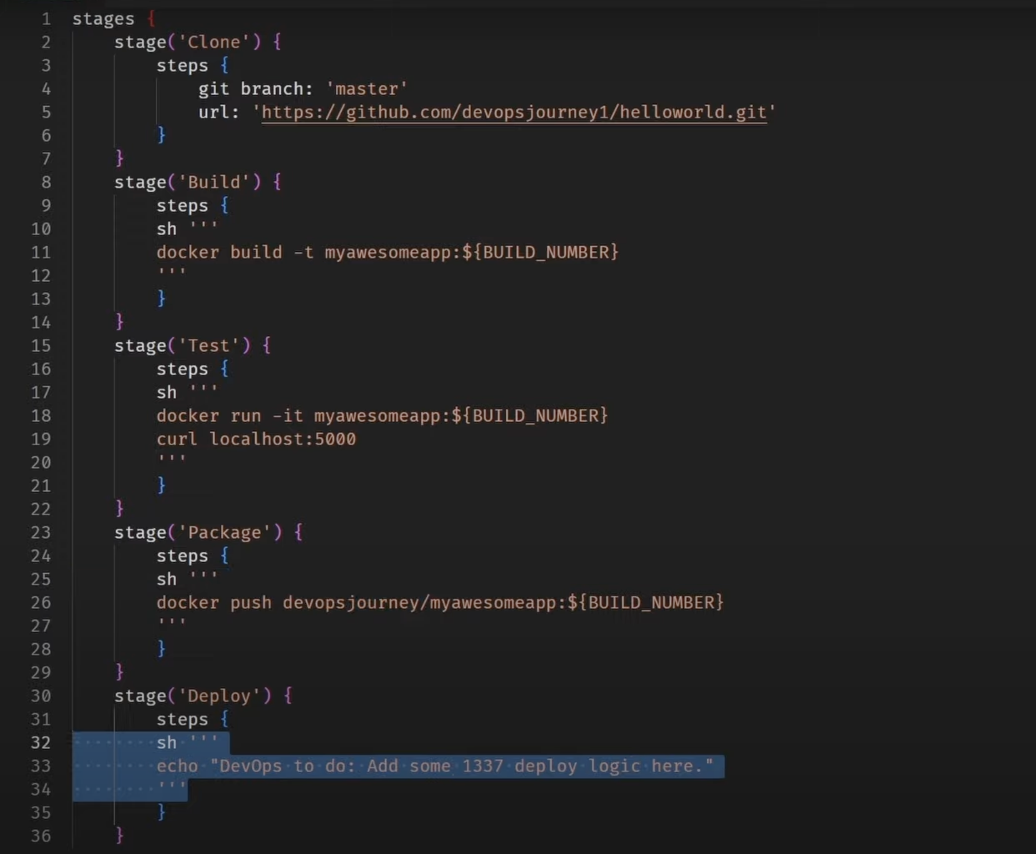
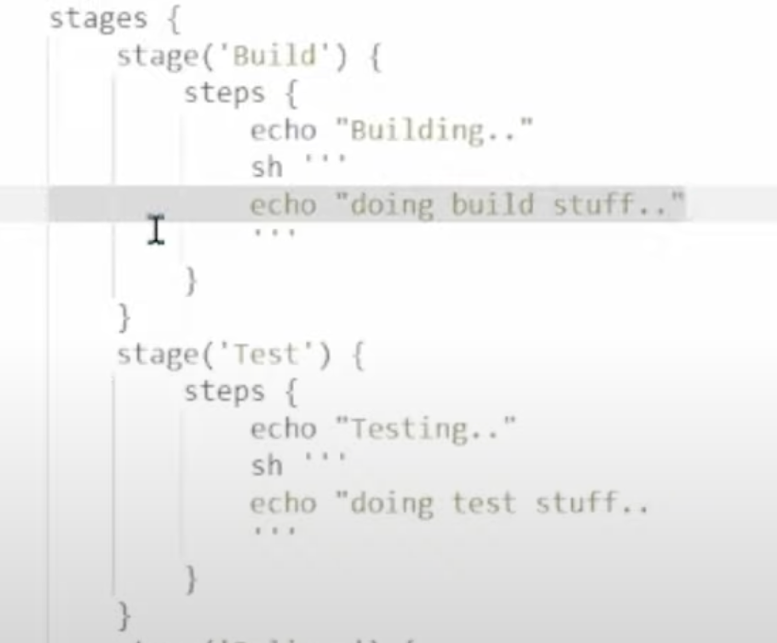

Slide 52
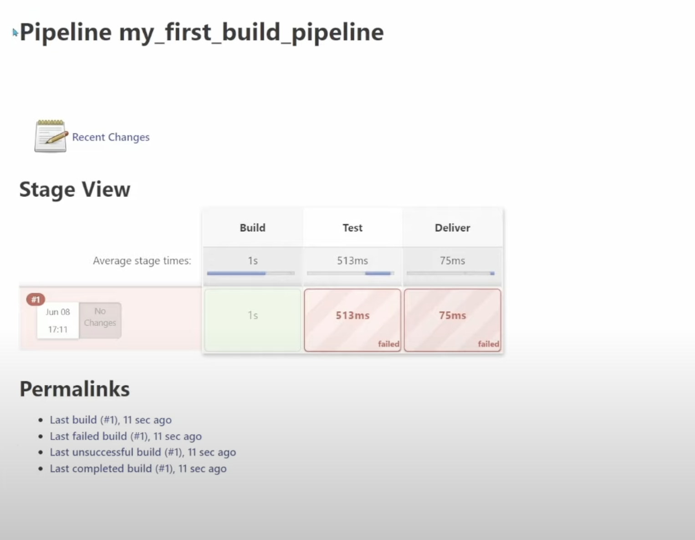
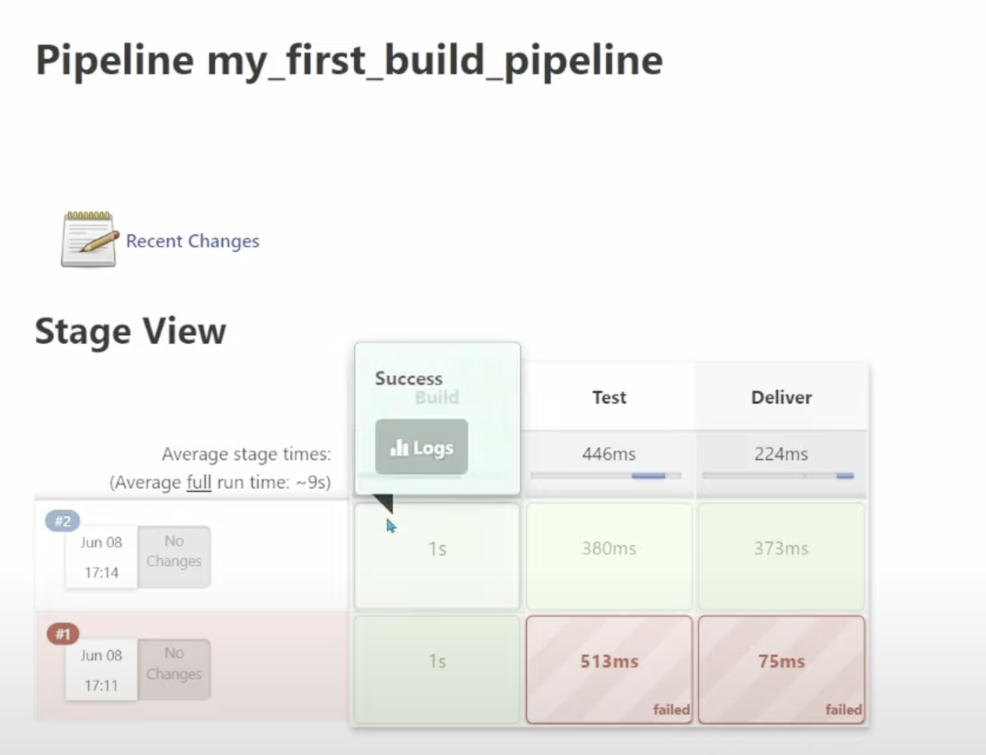

Slide 53
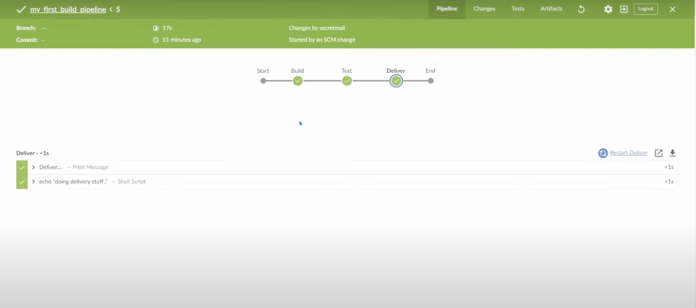
Blue Ocean

Slide 54

Thank You

